Slide 1





GOSHC Presentation
By Lily Dermanis

Slide 2
Contents
Purpose | To use my digital analytics skills in order to answer key business questions in supporting GOSHC's missions.
Data ingestion and analysis process | Understanding Quality Score
Tableau dashboard Output | General PPC optimisation
Evaluation and opportunties | Further opportunities
Mathematical thank you! | Thanking you all for the time taken to hear my analytical project and reminding you that together we can find positive mathematics solutions to improve children's lives!

Slide 3
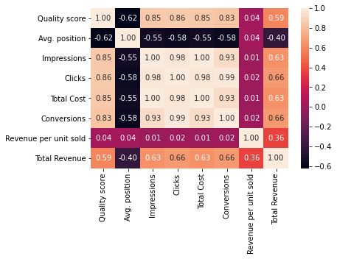
Understanding quality score:
Findings:
Metrics with a strong impact on quality score include Impressions, Clicks, Total Cost, Conversions.

Slide 4
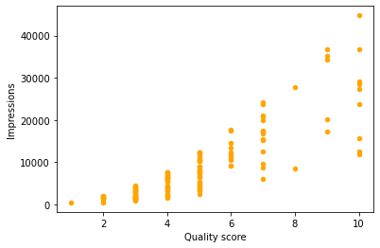
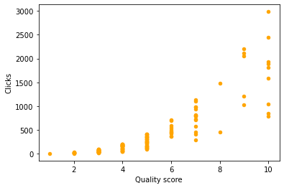
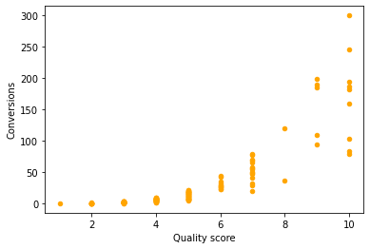
Understanding Quality Score:
Findings:
User interactivity measures have a significant impact on quality scores to include Impressions, Clicks and Conversions

Slide 5
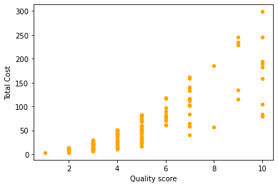
Understanding Quality Score:
Findings:
Financial measures have a significant impact on quality scores to include Total Costs.

Slide 6
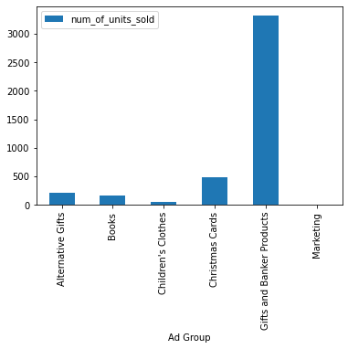
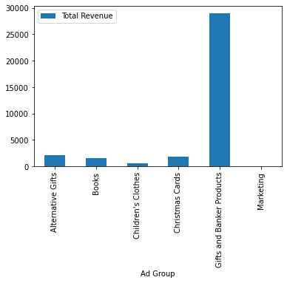
General PPC optimisation:
Findings:
We can assess the performance of GOSHC'S PPC portfolio for products by looking into the quantitative factors such as number of units sold and total revenue figures.
Most successful products are in Gift and Banker Ad Groups.

Slide 7
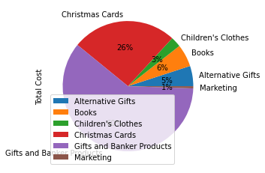
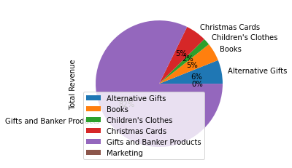
General PPC optimisation:
Findings:
We can maximise financial performance of GOSHC'S PPC portfolio by identifying groups with high and or low values of total revenues and total costs.
Gifts and banker ad groups have greater Total costs and total revenue, whereas, marketing isn't generating a share of revenue but is still costing GOSHC.

Slide 8
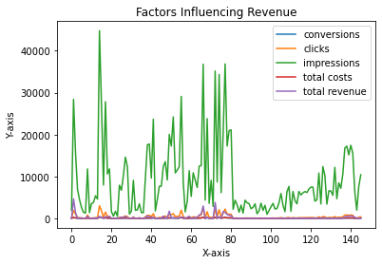
General PPC optimisation:
Findings:
We can maximise financial performance of GOSHC'S PPC portfolio by identifying factors which impact the revenue.
Insights drawn from the portfolio data shows that digital metrics such as clicks, impressions and conversions are high drivers for Gosh's performance.

Slide 9
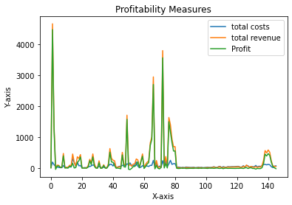
General PPC optimisation:
Findings:
We can measure the impact of performance of GOSHC'S PPC portfolio by evaluating profit and how closely this meets revenue and minimises costs.
In general, the total costs are lower than the total revenue for various ad groups.

Slide 10
General PPC optimisation:
How would we implement this in the business and measure the impact this has made as well as profitability:
Work closely with the advertising team to promote most popular products digitally, and additionally improve promotion and advertising for less popular products by using demand coefficient analysis to measure impact on customers.
Work with the finance department to understand long term costs and total revenues, and ways to ensure revenue exceeds costs to give a higher degree of profitability. Impact would be measured by calculating and visualising costs vs revenue for each data points to see impact fluctuations.
Maximise performance by capturing seasonal customer interactions for GOSHC'S product range and using time series analysis to measure, forecast and evaluate regular business impact.
Measure customer turnover and loyalty using percentiles and distribution analysis.
Additional ways in which we can assess the performance of Gosh's PPC portfolio for products as well as profitability and digital interactions:
Capture timestamps of impressions, conversions and clicks to understand product popularities
Capture further seasonal data to further enhance and drive successful product portfolios and assess performance in market climates.
Include demographical information to understand and target customer's demand for products to help drive the performance and minimise costs.
Apply customer retention figures.
Additional ways in which we can maximise the performance of Gosh's PPC portfolio as well as profitability and digital interactions:
Take into account quality of products and focus on maximising promoting these, and consider increasing marketing strategies for least popular products.

Slide 11
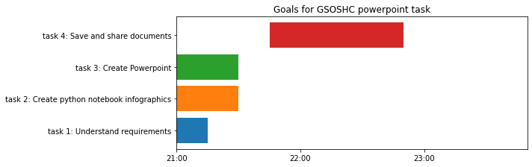
Evaluation and Opportunities
Overall, this infographic has helped us to identify key drivers for current performance, impact and ways we can measure impact and maximise financial performance using a variety of key measures.
However, it would be useful to look into how other operations and business areas can impact performance of GOSHC'S PPC portfolio as well as financial revenues and profitability. Examples could be looking into branding and advertising efficiency, customer demand, and seasonal buying behaviours.
Further opportunities could also be to carry out long and short term risks and successes of key measures on quality and financial performance using time specific data.

Slide 12

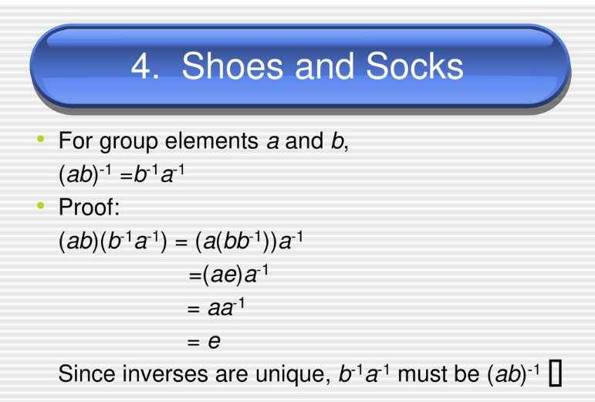

The end!
Thank you very much everyone for listening to my PowerPoint today! I hope you all enjoyed it and I welcome you to ask me any questions you have! Remember to keep smiling everybody and remembering maths can always help us find positive outcomes!☺

